Slide 1
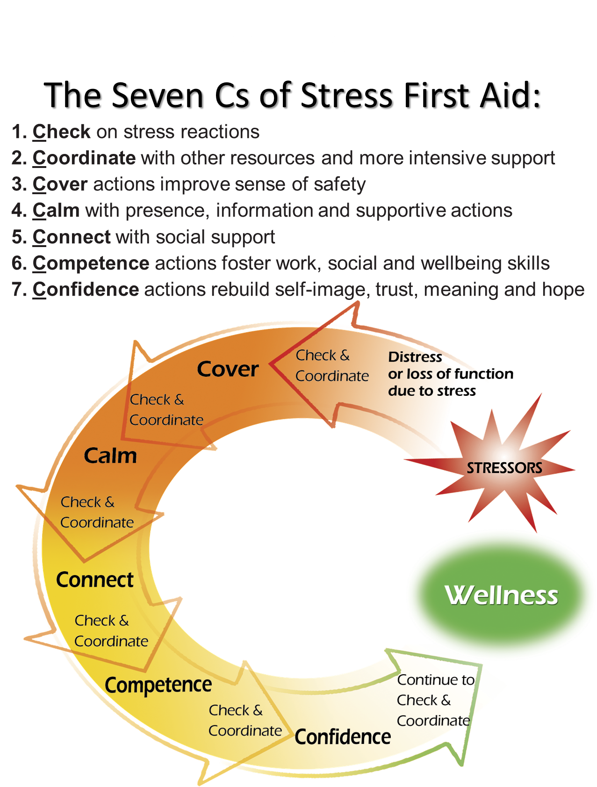
READY
Definition
REACTING
Definition
INJURED
Definition
ILL
Definition
Rested
Restored
Relaxed
Causes
Time for self care
Plenty of resources
Your Role
Accessing wellbeing resources
Self care
Other care
Strained
Able to recover
Causes
Normal daily stress
Not being pushed too far or too hard
Your Role
Alternate exertion with rest
Monitor your own well-being
Harmed by stress
Pain
Causes
Life threat
Loss
Moral injury
Wear and tear
Your Role
Recognize stress injuries early
Remember and use the 7 C’s of Stress First Aid
Disease
Loss of quality of life
Causes
Unhealed Orange Zone Stress injuries
Secondary conditions
Your Role
Link into care
Recover
Return
Impairment in functioning
Fulfilling roles
Rest & Relaxation
Offer support
Stress Continuum:
Definition, Causes, and Your Role
Stress First Aid
Notes:
Stress Continuum Model
The Stress Continuum Model was developed as a visual tool for assessing an individual's stress experiences, zones of stress, and stress responses. It forms the foundation for Stress First Aid. It also indicates that four possible types of stress “injury,” trauma, loss, inner conflict / moral injury, and long-term chronic stress, or “wear and tear,” might move a person from the Yellow Zone of stress the Orange or Red Zones.
Stress responses lie along a spectrum of severity and type — from transient and mild to chronic and debilitating. The continuum has four zones: Ready (Green), Reacting (Yellow), Injured (Orange) and Ill (Red). It is important to note that 100% of people will react when faced with significantly stressful experiences. However, the way in which they respond will depend on many factors, including how prepared they are for the stressor and how they interpret it. A person’s reaction can range relatively rapidly from Green to Yellow to Orange to Red and back again.
Stress First Aid was adapted from the Navy/Marine Corps Combat Operational Stress First Aid (COSFA). The Stress Continuum Model was developed as a visual tool for assessing an individual's stress responses and forms the foundation for both COSFA and SFA. It was also designed to reduce stigma by showing that people can go in and out of ranges of stress reactions frequently, based on a variety of factors.
This Model acknowledges that within this range of reactions to stress, a person can go from being in optimal functioning, feeling good, mentally and physically fit, mission focused, calm, and motivated into what's called a yellow zone where they’re having more stress reactions, but the stress reactions are mild and or transient, and always go away. In the yellow zone a person can feel more irritable anxious or down, have a loss of motivation, loss of focus, have trouble sleeping, or have muscle tension or other physical changes, but these are transient reactions.
Once a person gets into the orange zone it's usually caused by an accumulation of different types of stressors or a pretty severe stressor. In the orange zone you start to see more severe and persistent distress or impairment, the person doesn't feel like themselves, or they have a loss of control of their stress reactions. They might feel strong panic on depression, rage, guilt, or blame. In this zone it starts to feel like the stress "leaves a scar,” and the person is at high-risk for having trouble functioning and or strong or persistent distress.
The red zone is usually reserved for diagnoses like PTSD, depression, anxiety, or substance-abuse. What signifies a person being Red zone is that their symptoms are very persistent or worsen over time, or the person experiences severe distress, or has significant difficulty functioning at work or in their home life.
The stress first aid model was designed to help people move themselves or their coworkers from the red and orange zones back to the yellow or green zones.
The ethos in many high stress work cultures has been that after a difficult event, one should be able to “tough it out”. This is still the case in many settings, where the stigma associated with reacting to stress or stress injury behaviors is still very real and people will try to conceal stress reactions from supervisors to avoid medical or psychological intervention.
However, it is usually not possible to keep these behaviors hidden for long from family members, coworkers. and friends. When a co-worker recognizes that someone is in trouble, it is important to break the code of silence. Getting this individual connected with the next level of help as soon as possible may help prevent their reaction from progressing into the Red Zone. And once an individual has moved into the Red Zone, the goal is to help get them into treatment as soon as possible.

